Slide 1
UI SWITCHES
Computing – Faculty of Business, Law and Digital
martin.reid@solent.ac.uk

Slide 2
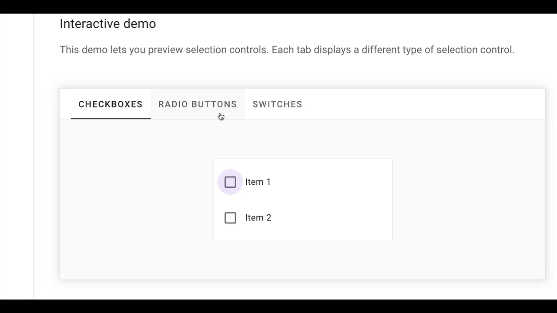

Slide 3
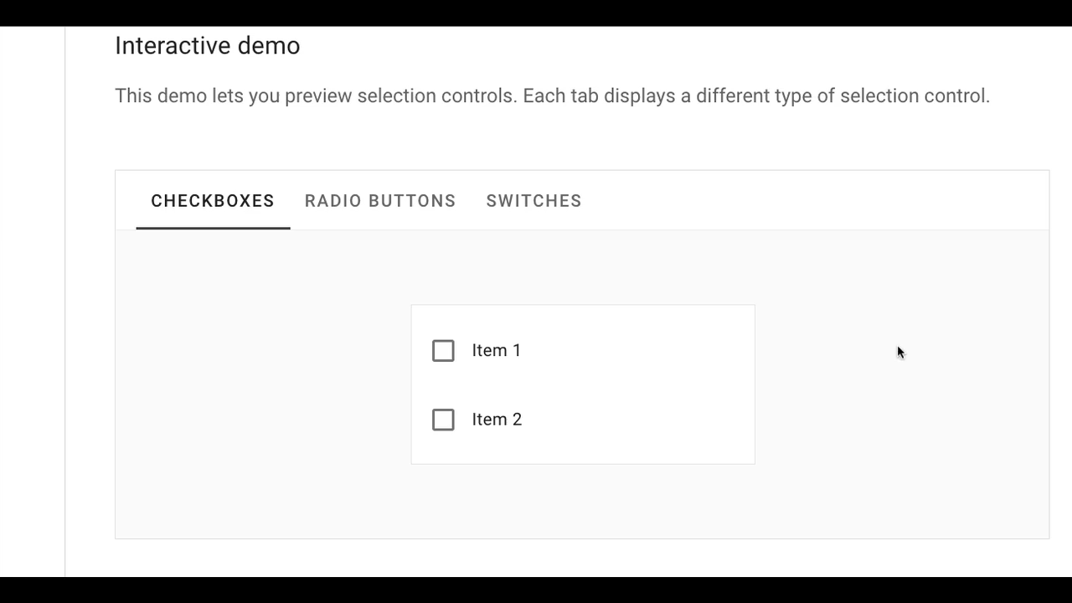

Slide 5
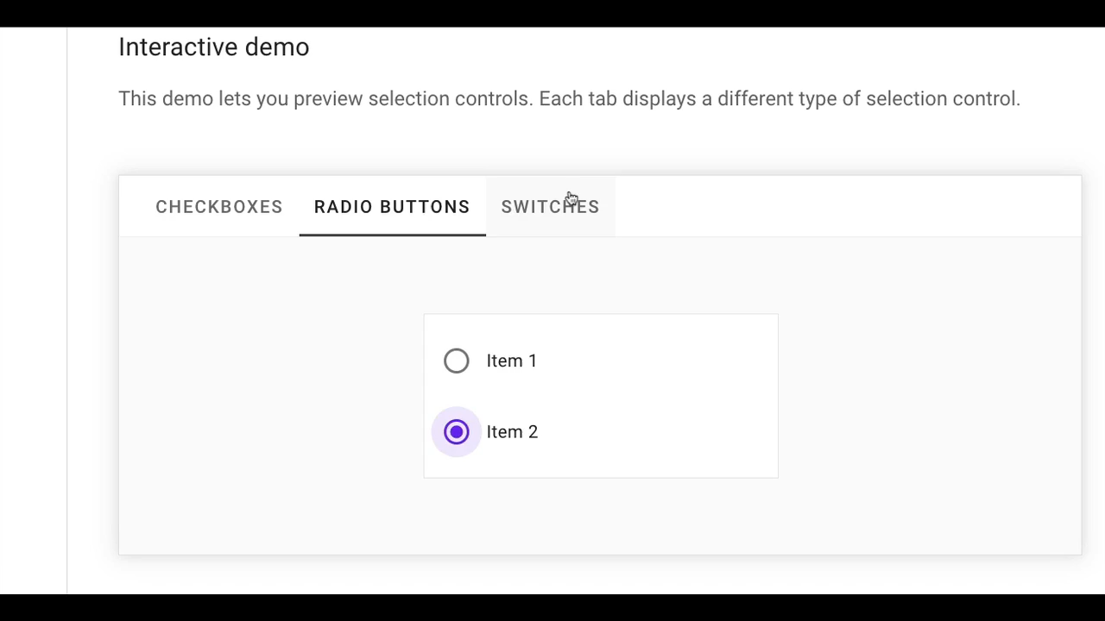

Slide 6
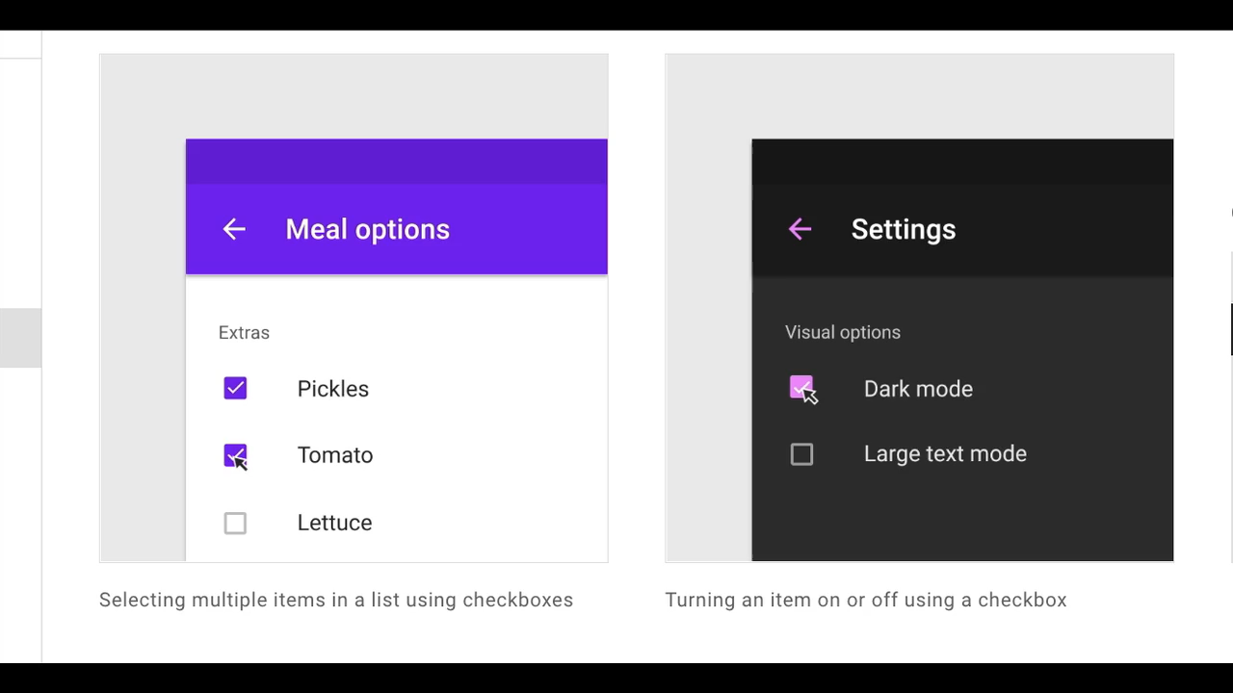

Slide 7
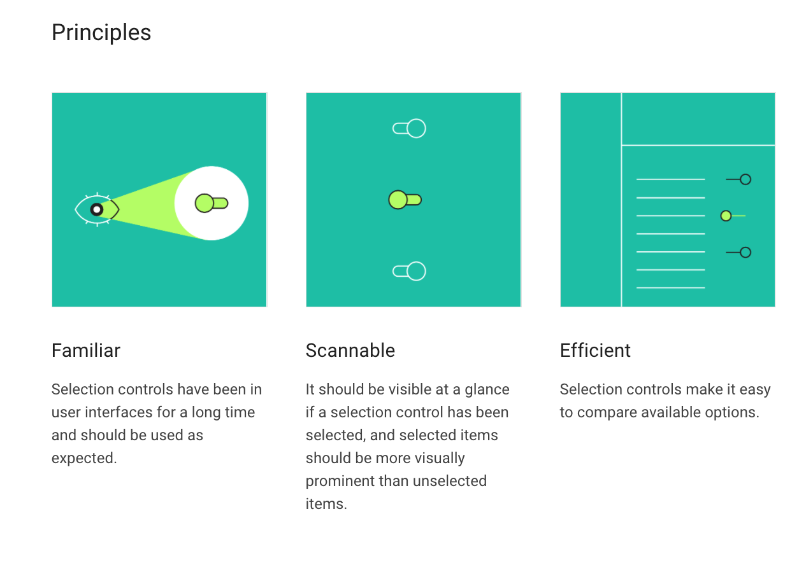
MATERIAL DESIGN, 2020. Material Design [viewed 29 November 2020]. Available from: https://material.io/components/selection-controls
‌

Slide 8
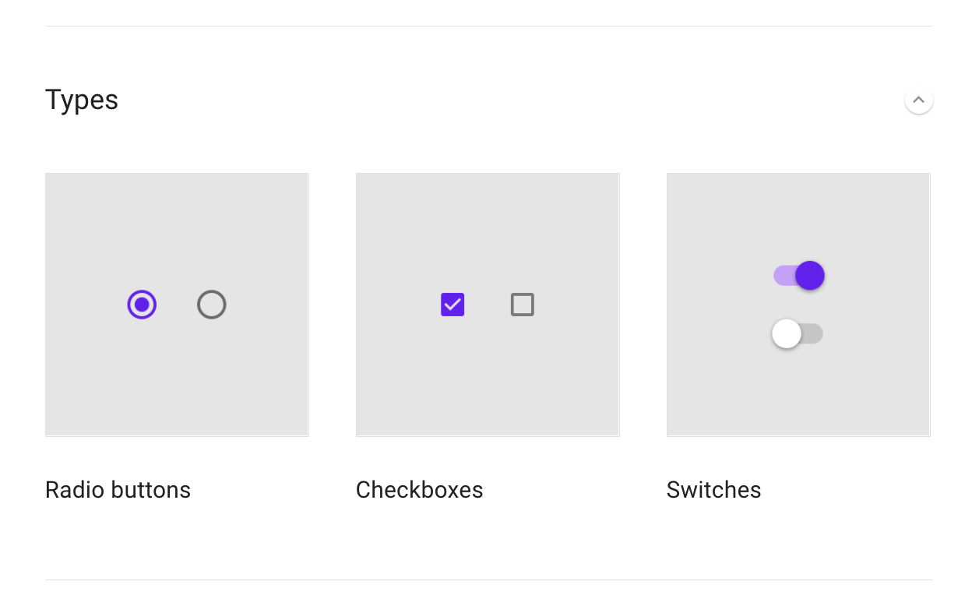

Slide 9
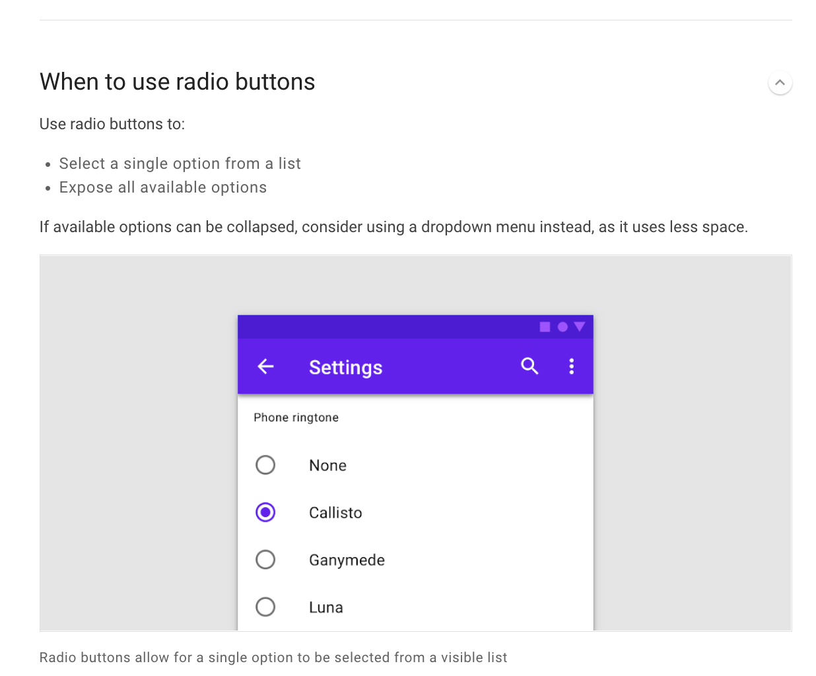

Slide 10
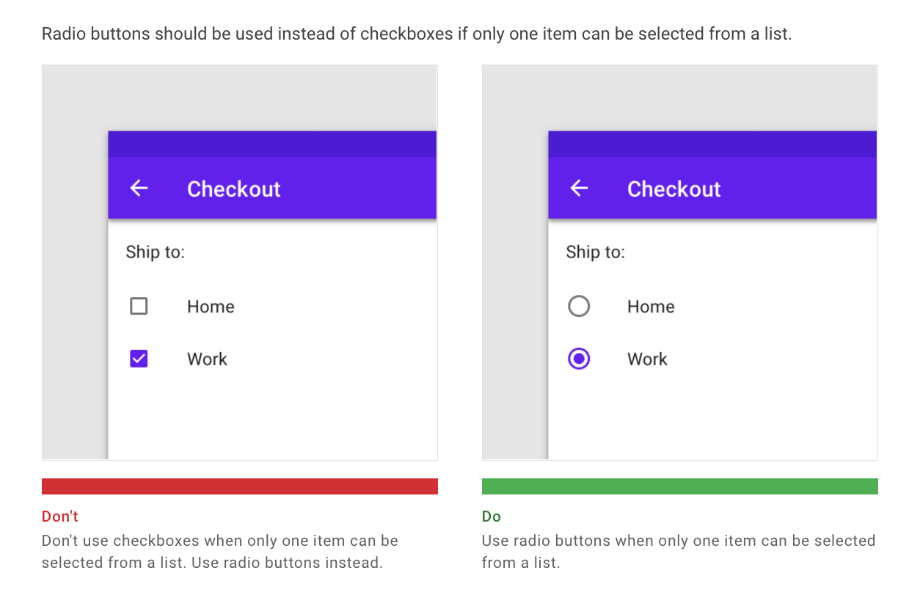

Slide 11
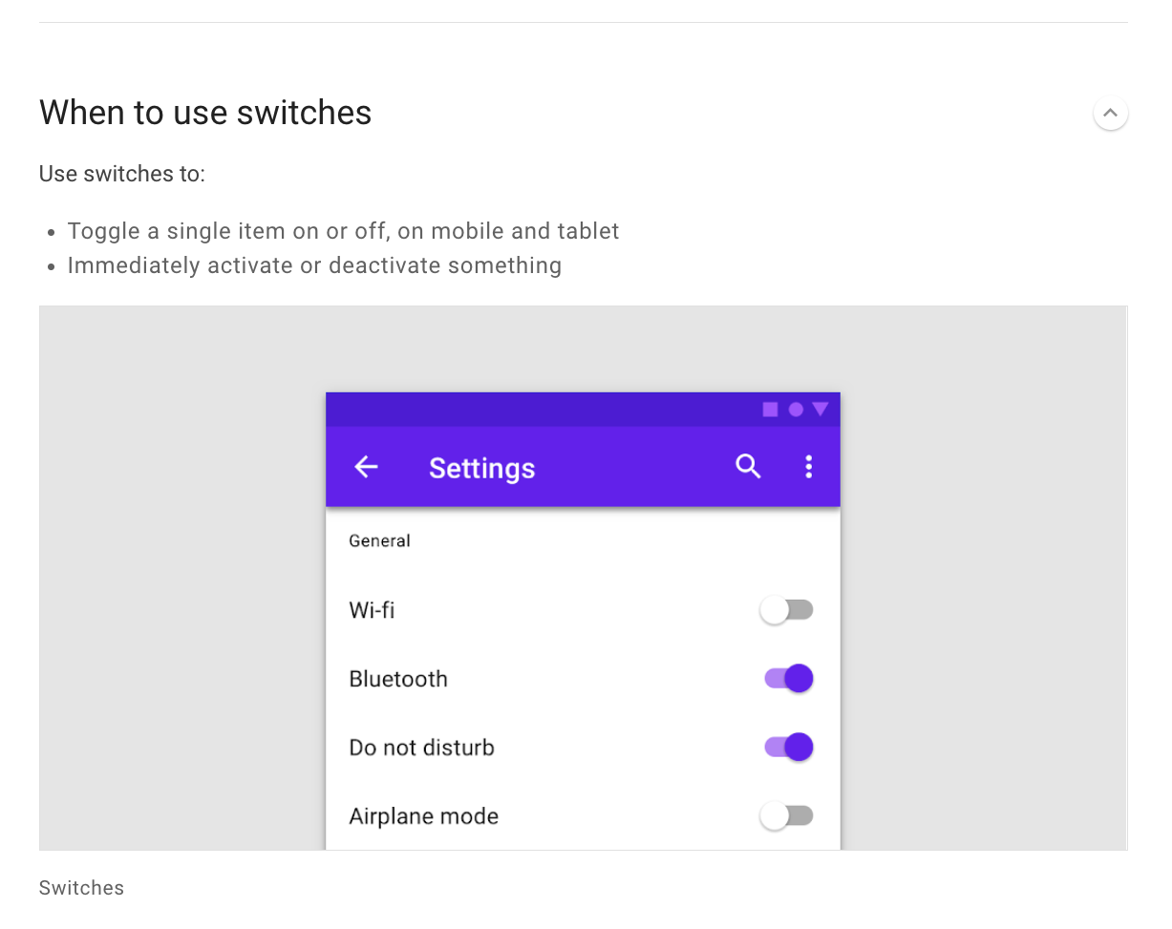

Slide 12
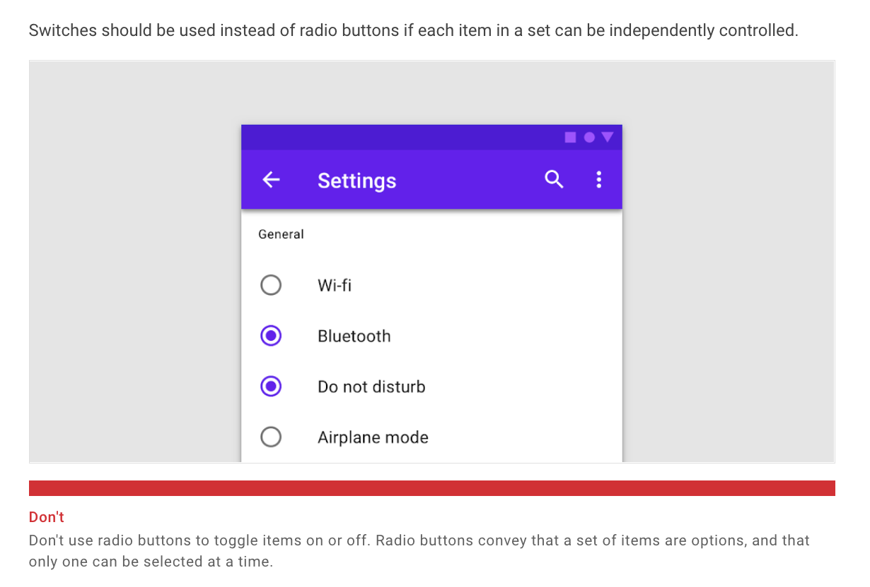

Slide 13
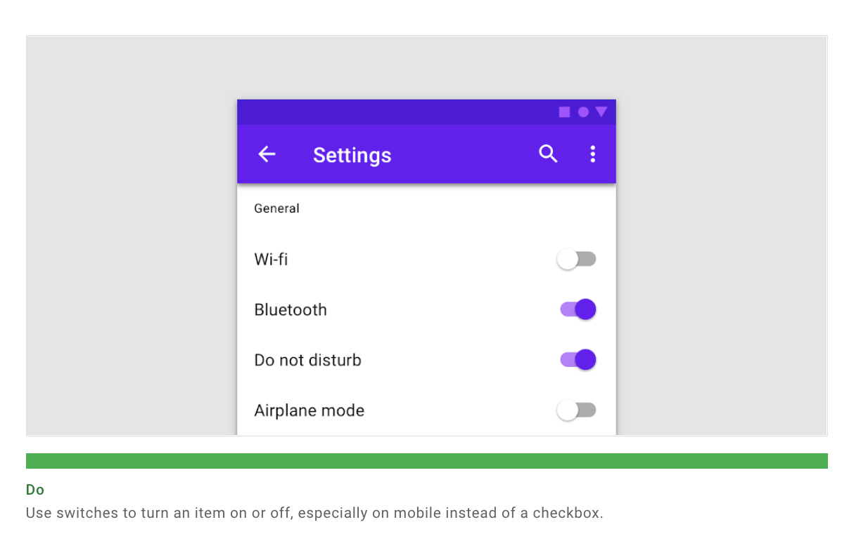

Slide 14
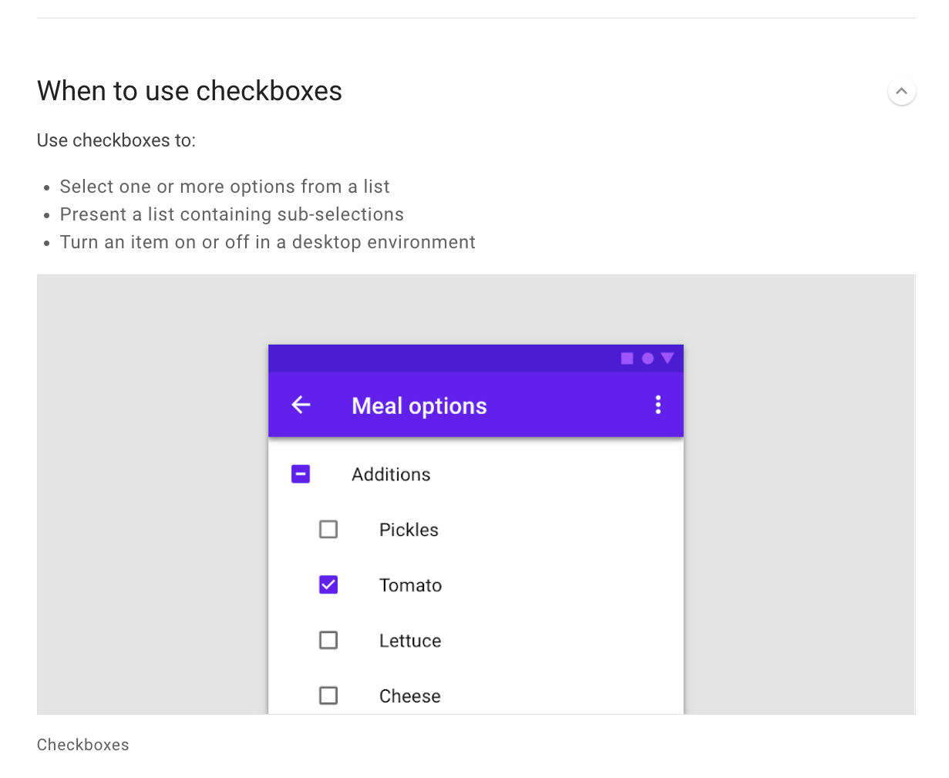

Slide 15
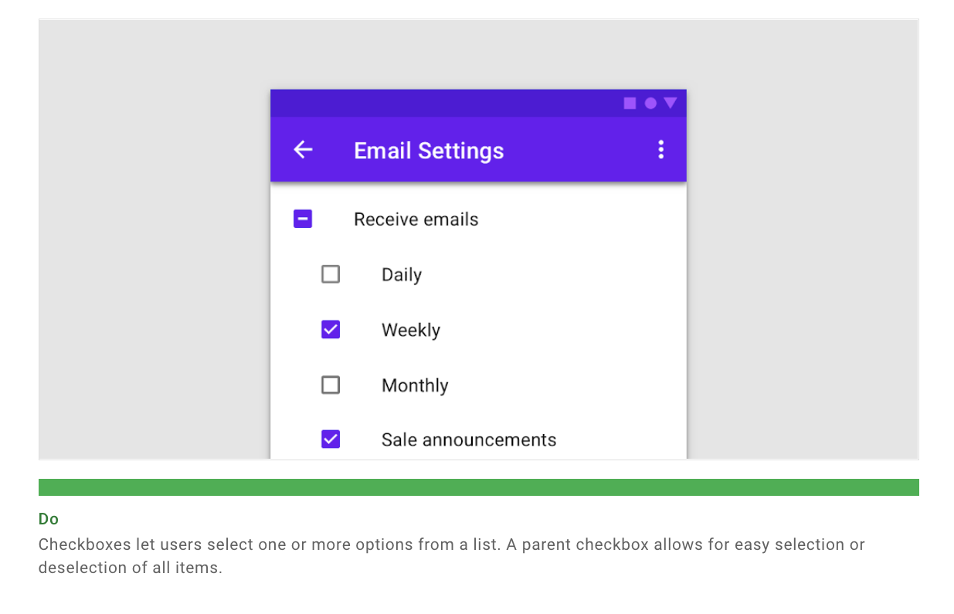

Slide 16
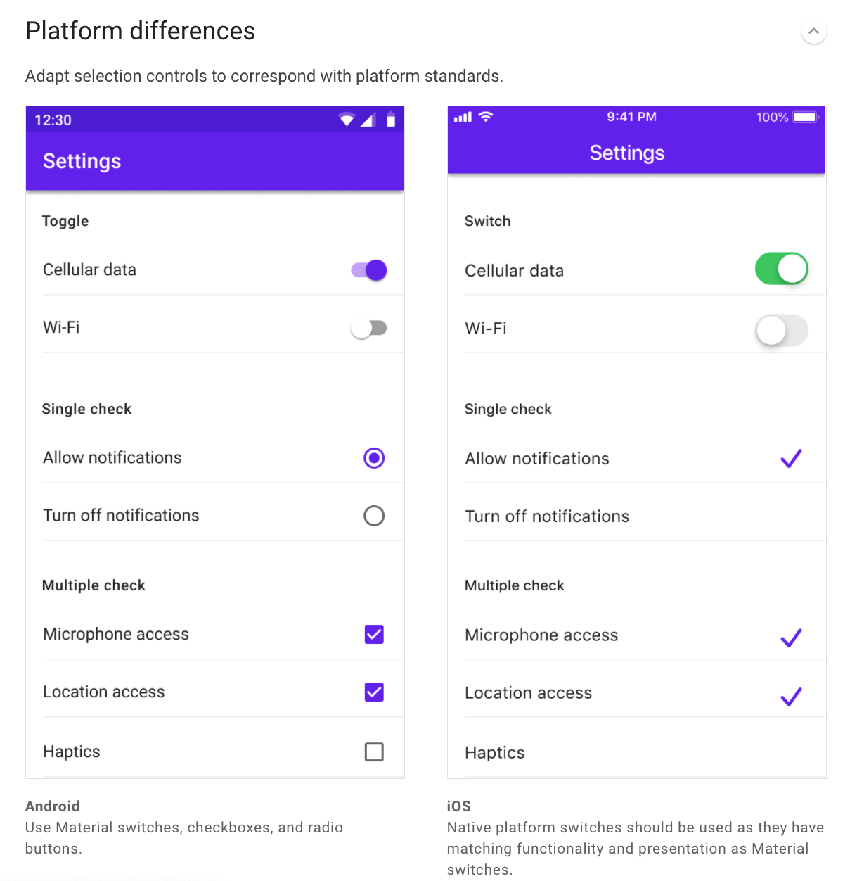

Slide 17
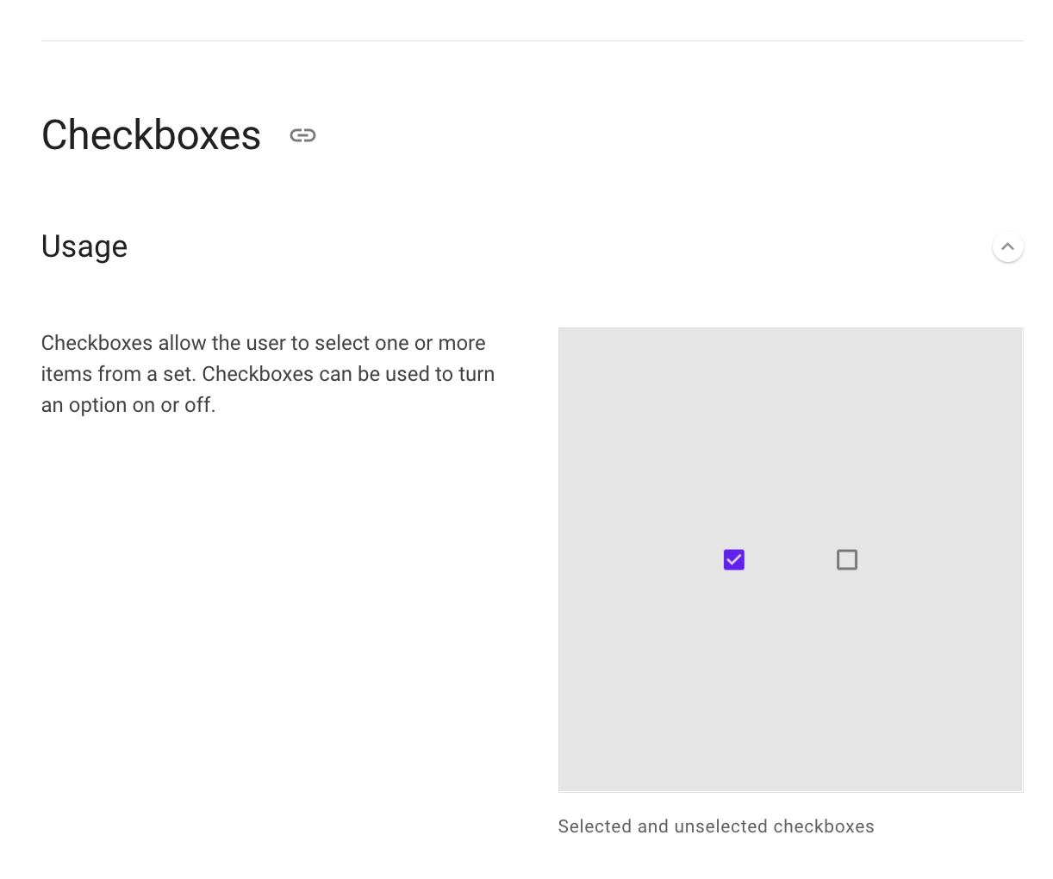

Slide 18
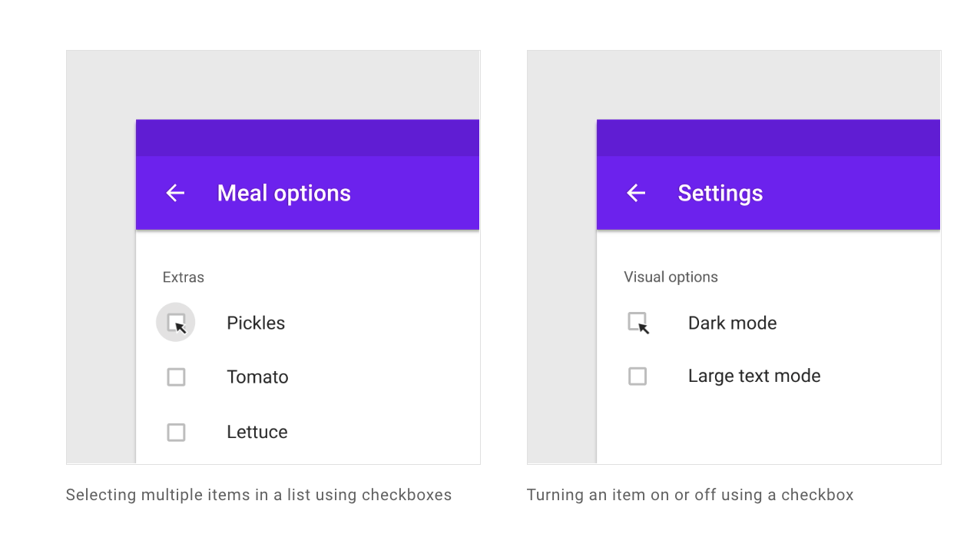

Slide 19
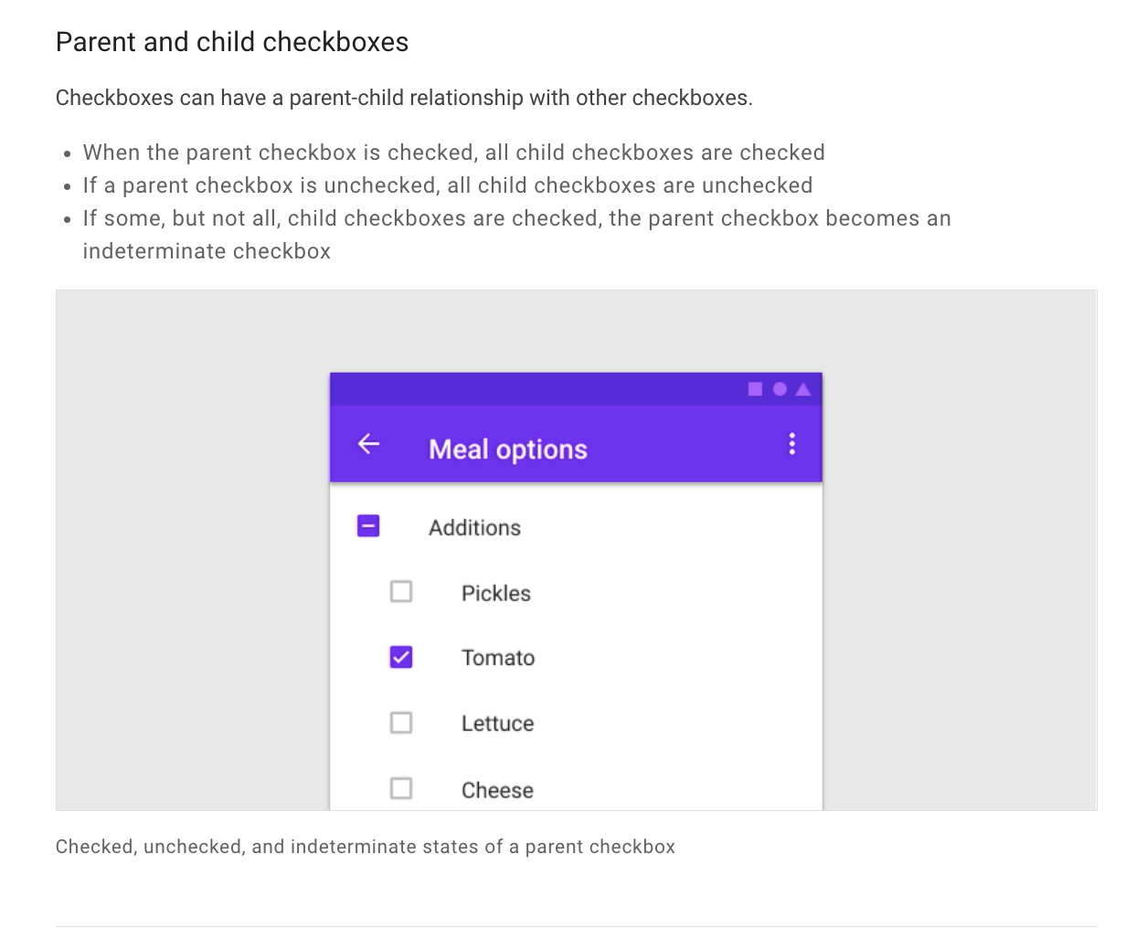

Slide 20
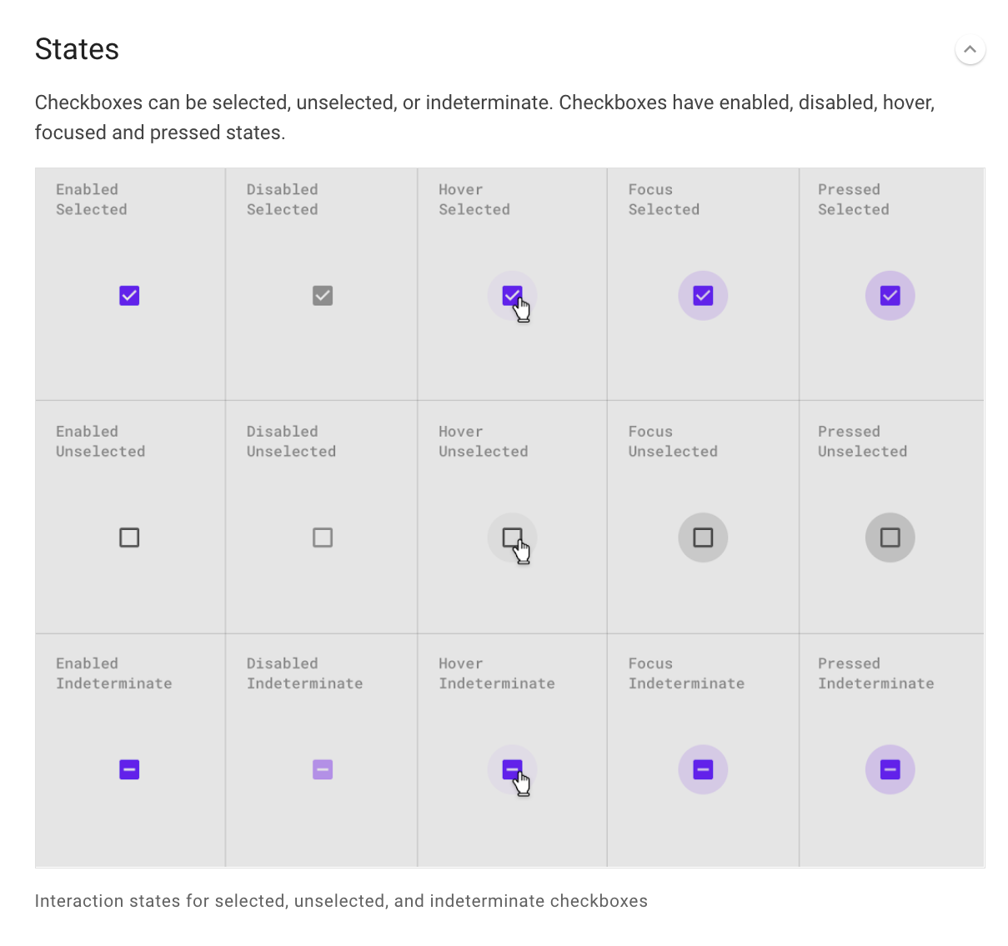

Slide 21
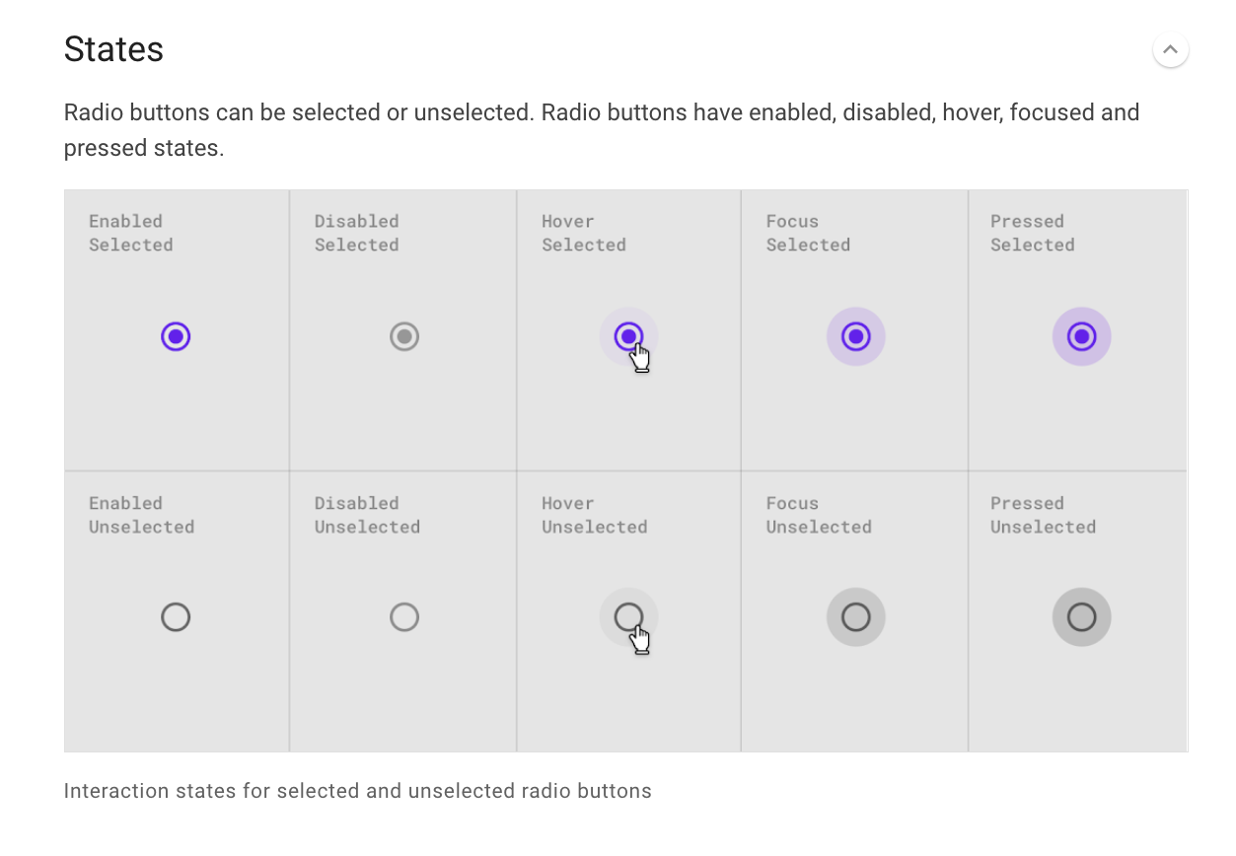

Slide 22
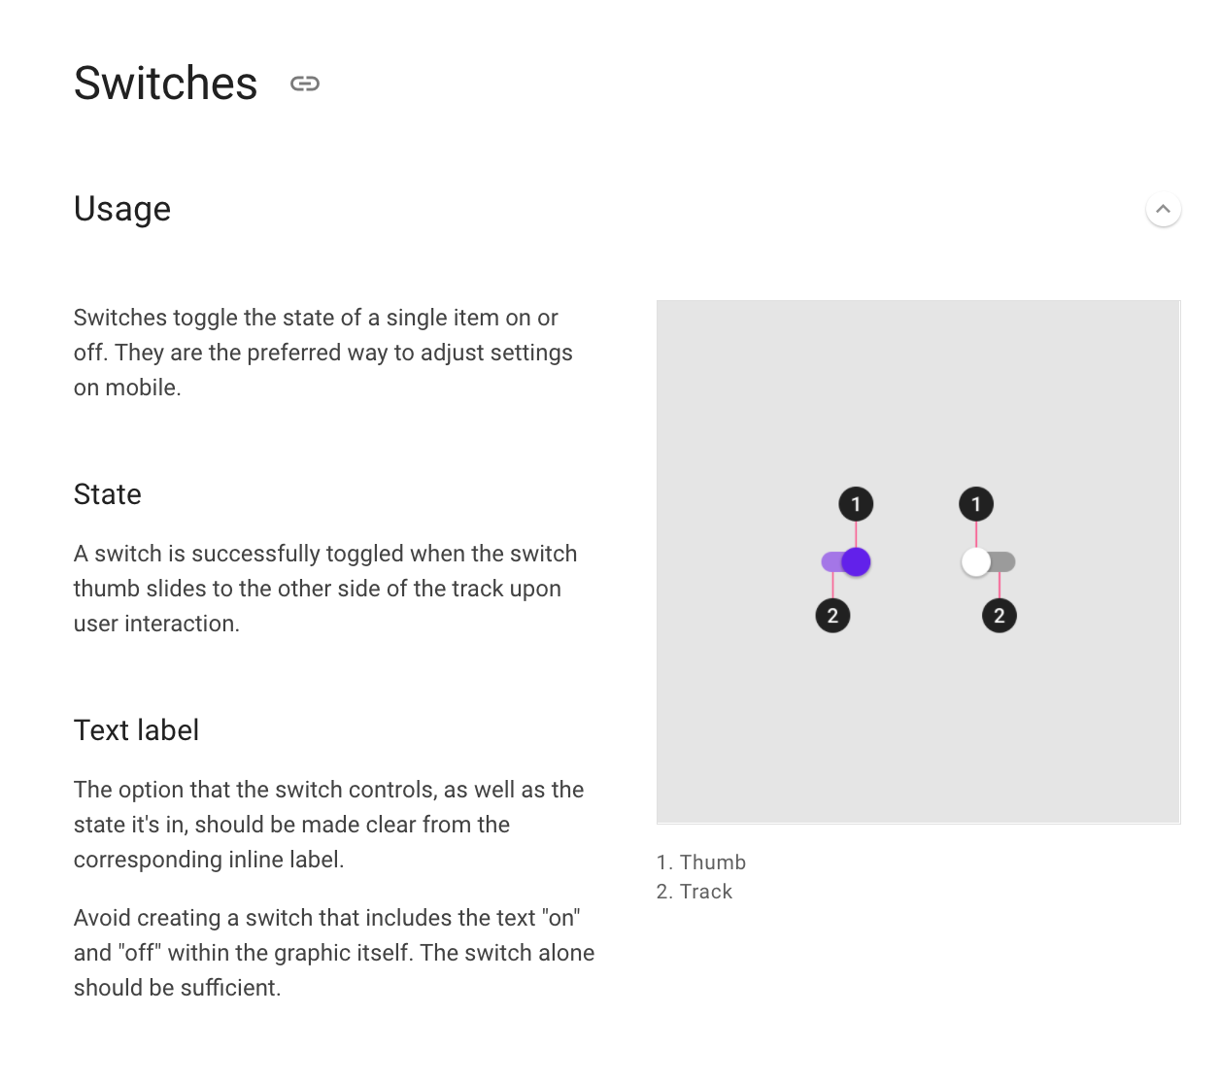

Slide 23
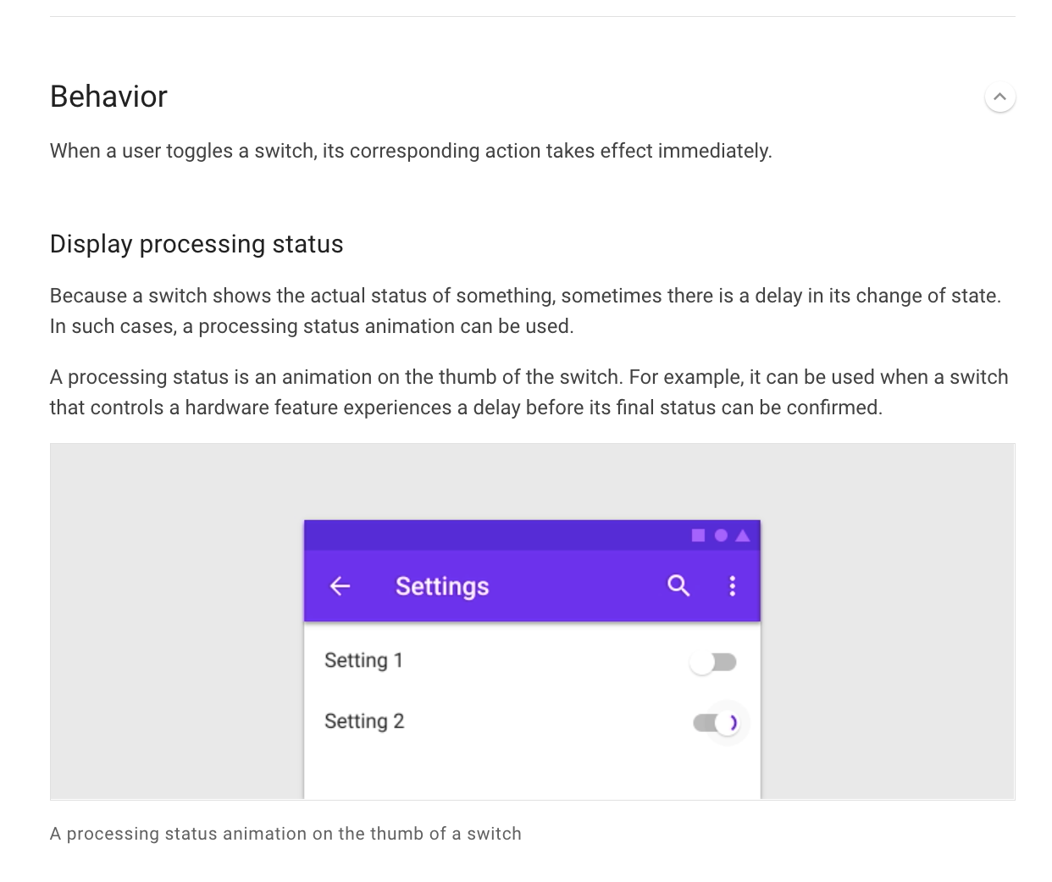

Slide 24
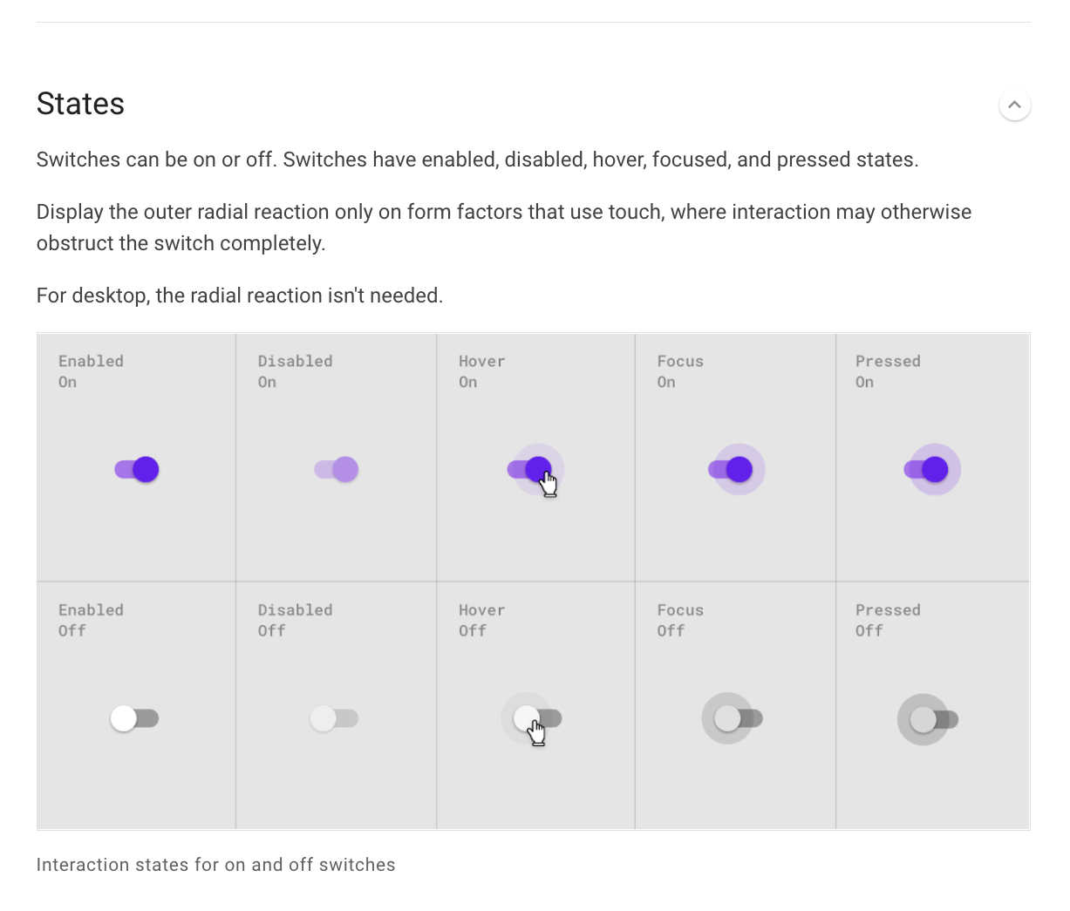

Slide 25
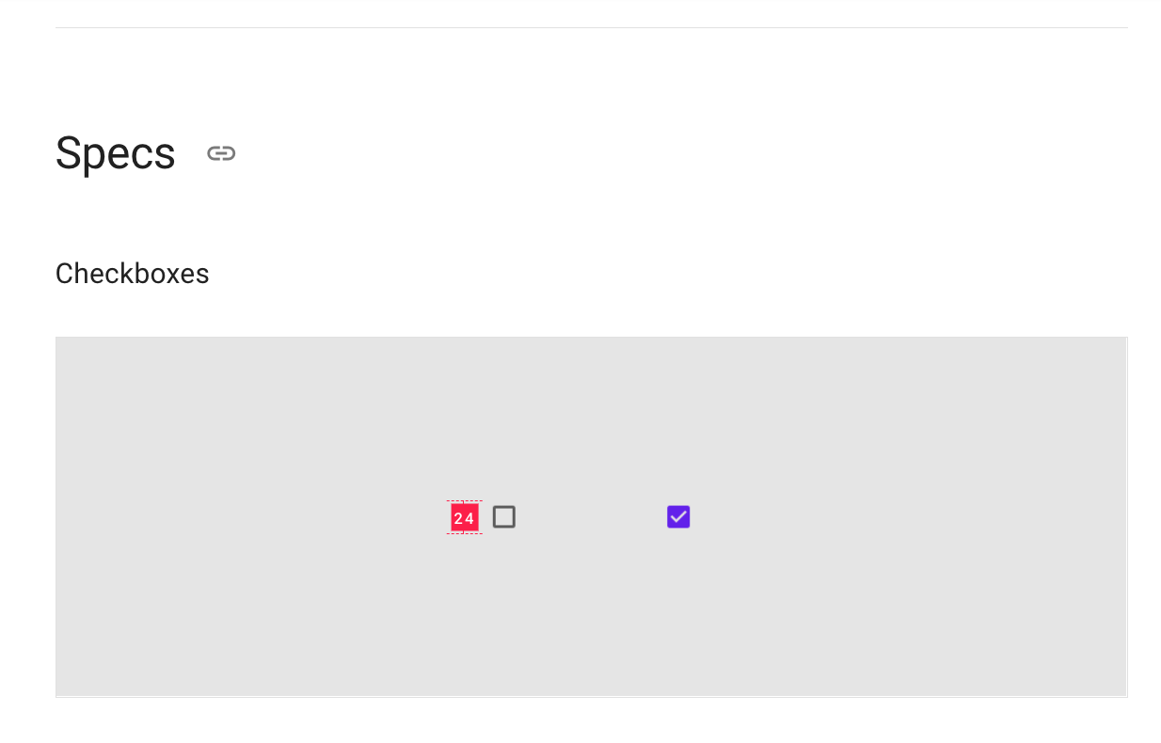

Slide 26
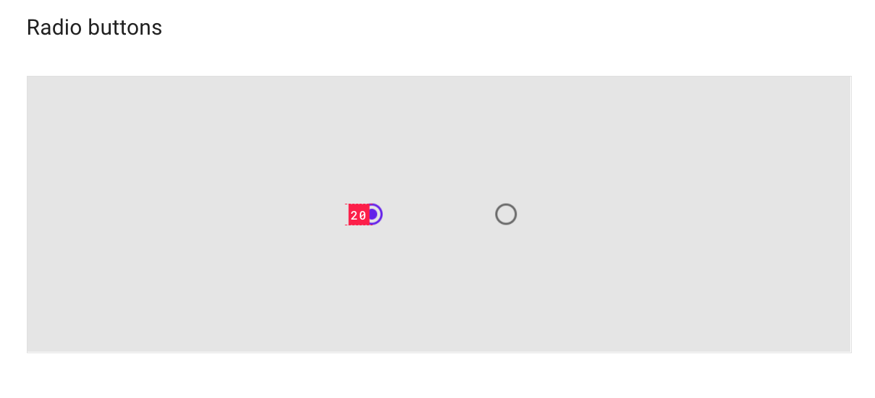

Slide 27
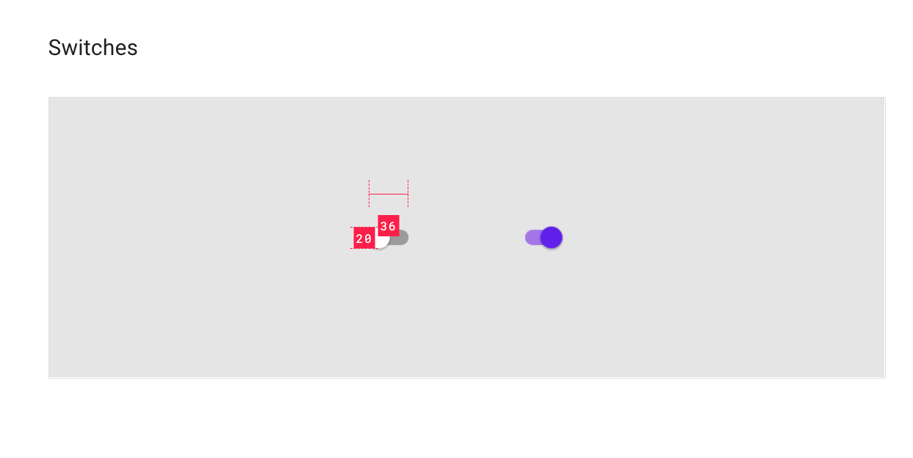

Slide 28
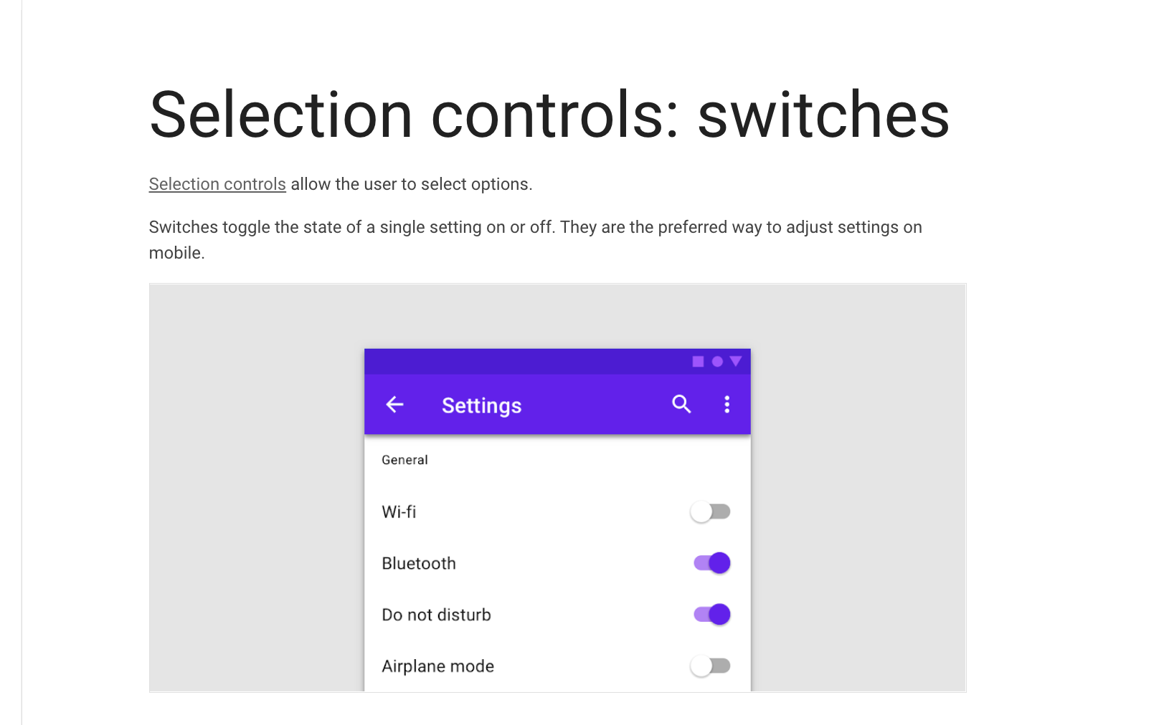

Slide 29
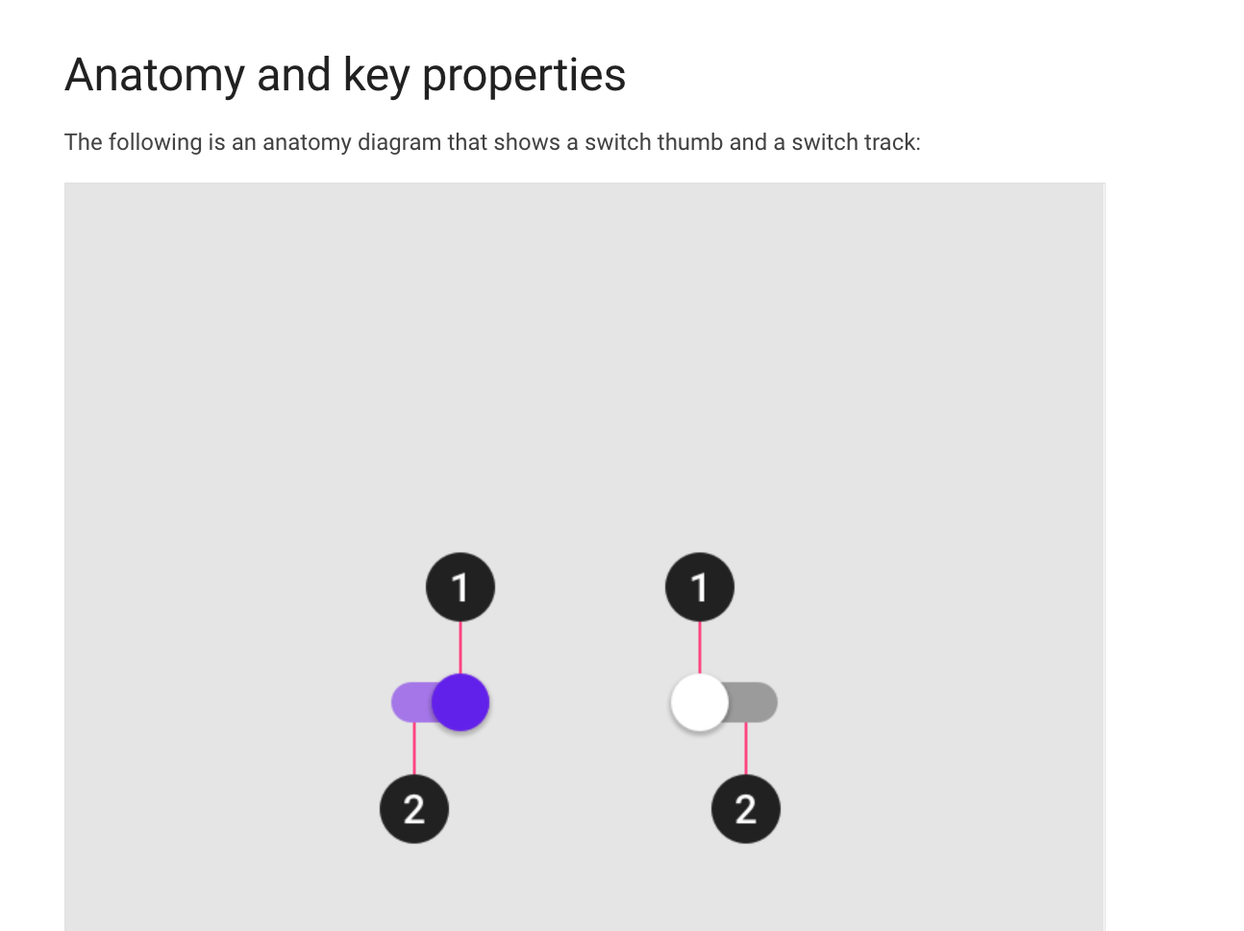

Slide 30
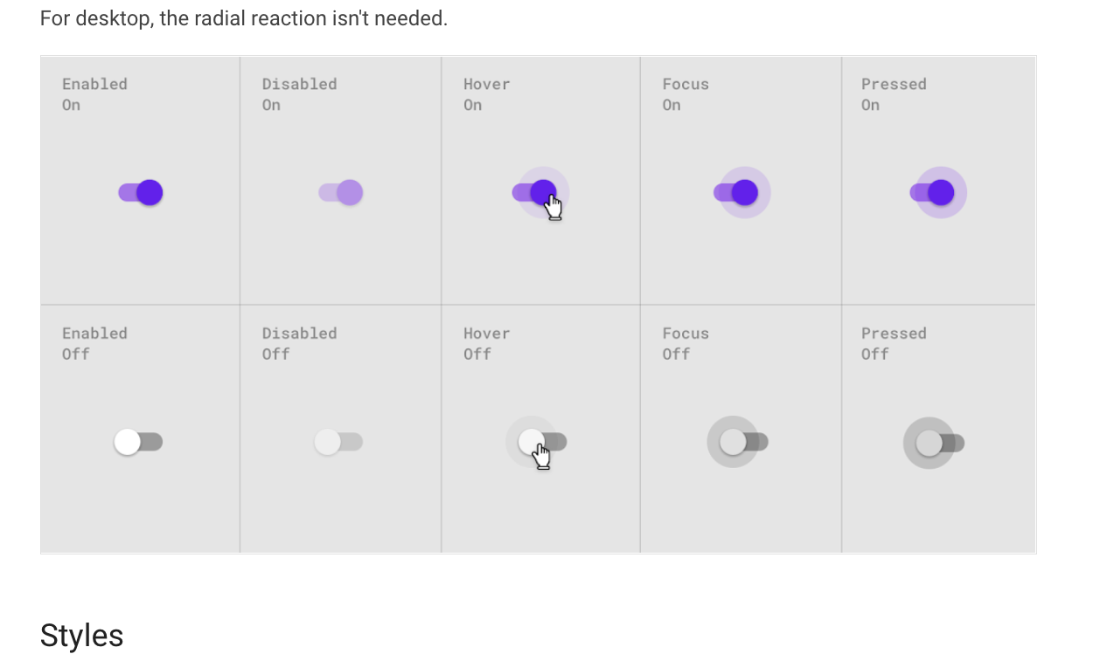

Slide 31
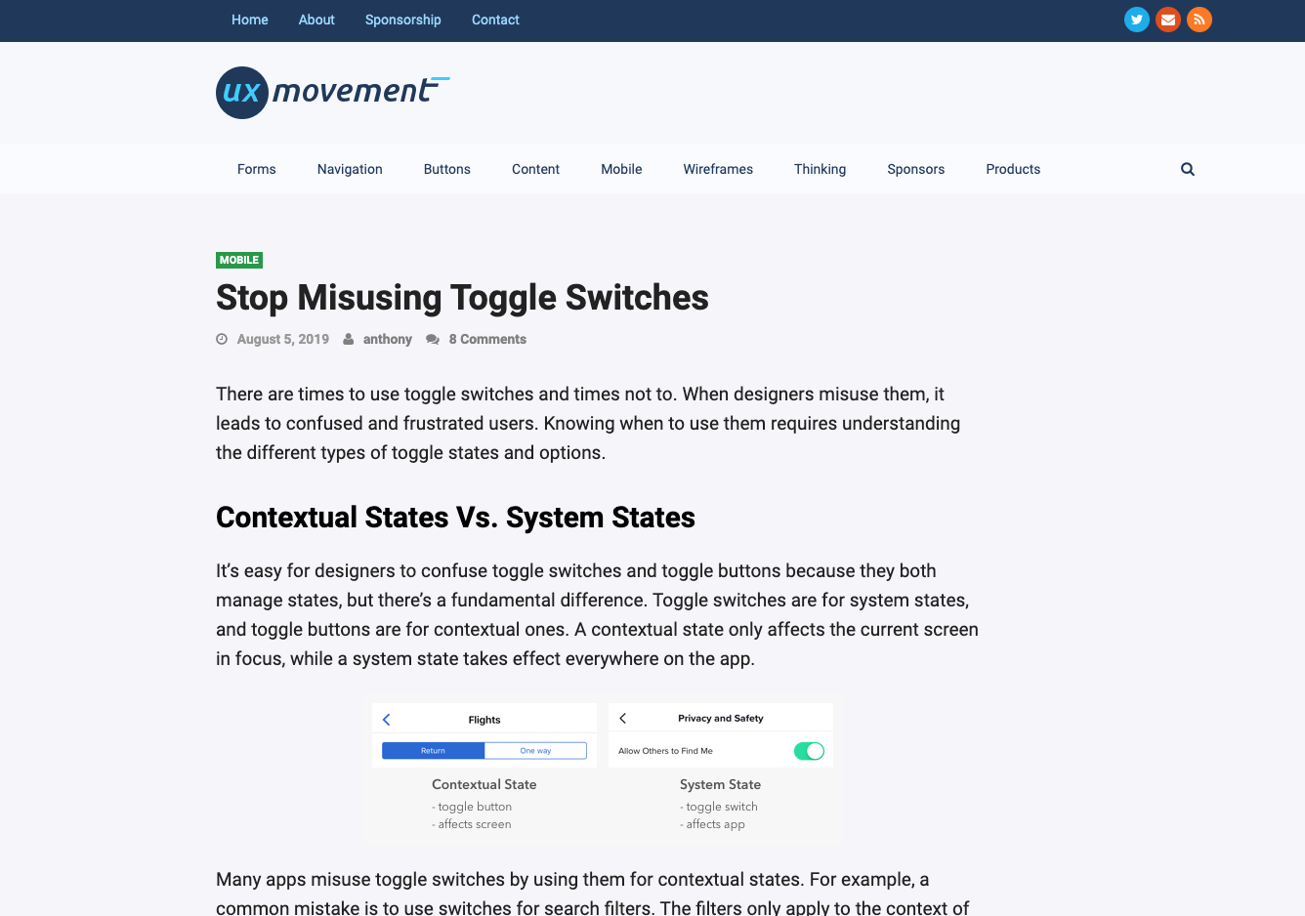
uxmovement.com., 2019. Stop Misusing Toggle Switches [viewed 30 November 2020]. Available from: https://uxmovement.com/mobile/stop-misusing-toggle-switches/

Slide 32

justinmind.com., 2020. Toggle switch design: the full run through [viewed 30 November 2020]. Available from: https://www.justinmind.com/blog/toggle-design-patterns-examples/
‌

Slide 33
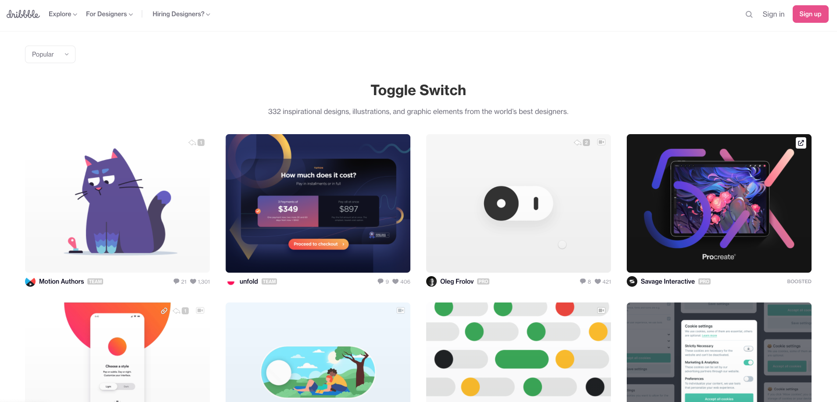
https://dribbble.com/tags/toggle_switch

Slide 34

https://dribbble.com/shots/6789054-Infinity-Love

Slide 35

https://dribbble.com/shots/6789054-Infinity-Love

Slide 36
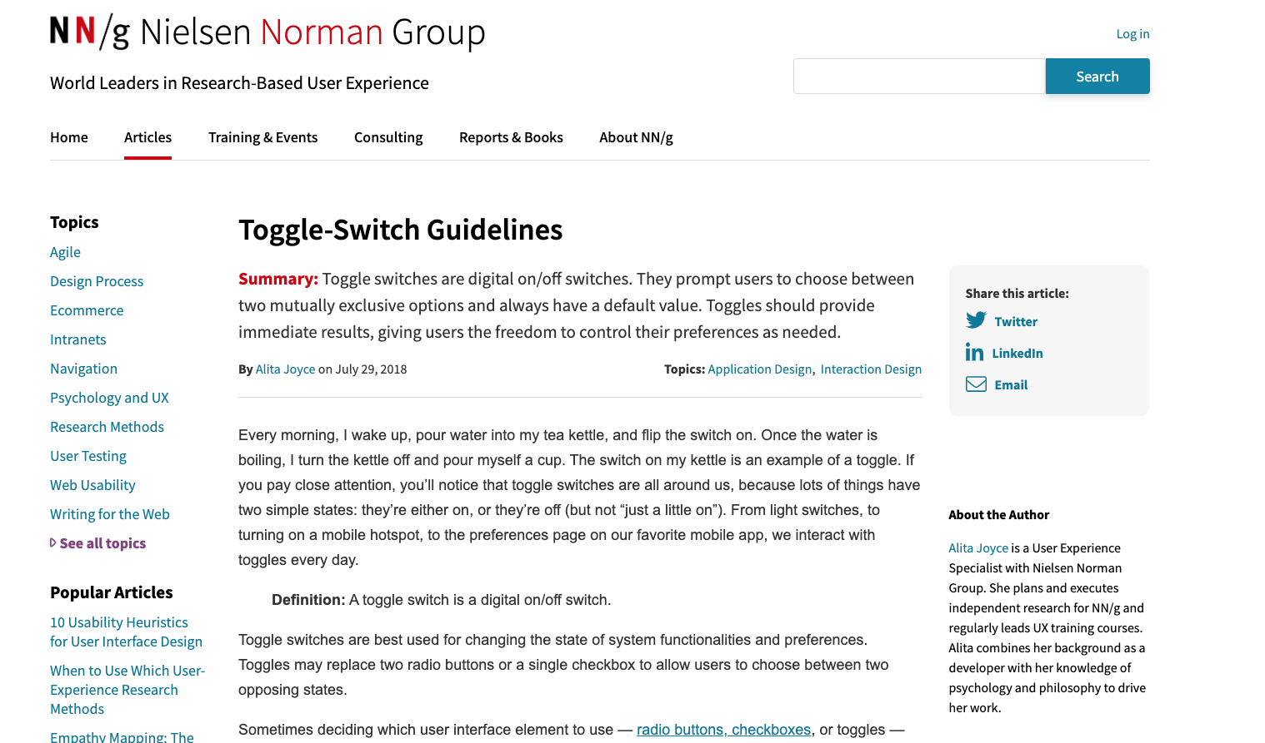
nngroup.com., 2018. Toggle-Switch Guidelines [viewed 30 November 2020]. Available from: https://www.nngroup.com/articles/toggle-switch-guidelines /
‌

Slide 37
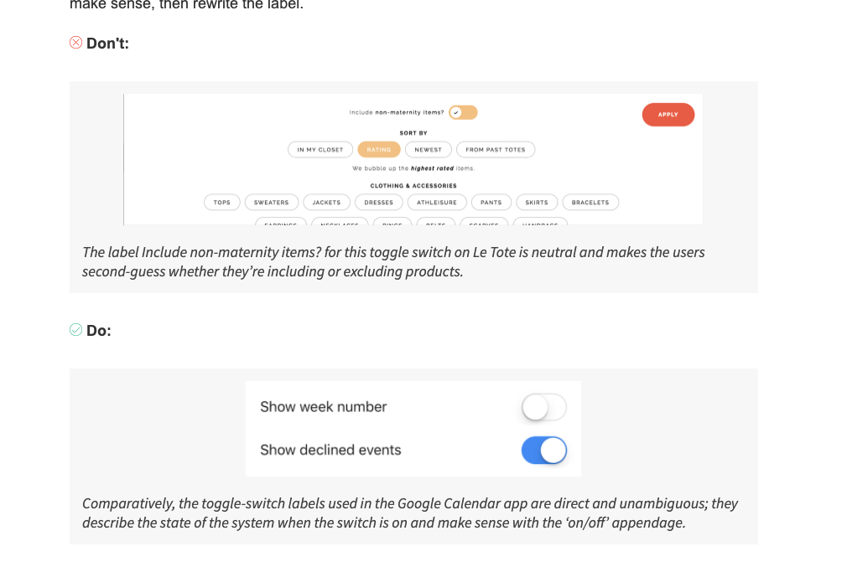
nngroup.com., 2018. Toggle-Switch Guidelines [viewed 30 November 2020]. Available from: https://www.nngroup.com/articles/toggle-switch-guidelines /
‌

Slide 38
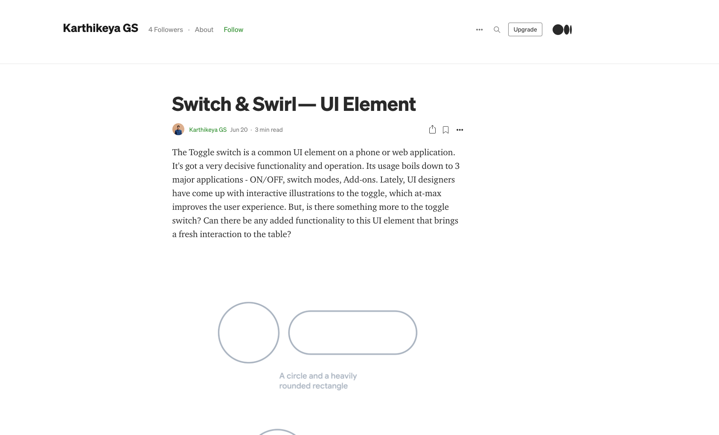
KARTHIKEYA GS, 2020. Switch & Swirl — UI Element - Karthikeya GS - Medium [viewed 30 November 2020]. Available from: https://medium.com/@karthikeya0798/switch-swirl-ui-element-51bee23fe020
‌

